Slide 1
ESE PRESENTATION 2
Guide: Dr Nizar Banu P K
Presented by,
Lynford Valentino D’souza 2047221
Yash Himmat Kataria 2047235
Sumi Thomas 2047259

Slide 2
Project Title: Feasible Real Time Helmet Detection Using Microcomputers

Slide 3
Outline
Abstract
Proposed System – Workflow
Problem Analysis and Research
Model Testing and Training
Data Collection and Refinement
Data Collection
Data Labelling
Data Refinement
Model Training and Testing
App Design and Testing

Slide 4
Abstract
Ever-increasing population, Two-Wheelers most popular mode of transport, Disadvantage of safety, Maximum cases result in fatal injuries.
Helmets, Extremely effective, Governments - punishable offense to ride the bike without a helmet.
Law Enforcement, Police Officers, Significant proportion of their time spotting riders without helmets, Stopping them and issuing them with traffic violation tickets, Time wastage, Incapability of catching each and every violator, Significant portion of the population avoid using the helmet.
Our project, Automation of the entire process, freeing up the time of police officers, reducing traffic issues and ensuring the safety of citizens. The proposed system will use the Efficient Net Lite0 model for object detection. The model once trained will be converted to a TensorFlow Lite format and then Quantized to improve overall efficiency and effective cost.
The proposed system will automatically detect bike riders not wearing helmet using a microcomputer like Raspberry Pi 4 along with a security camera and do the processing on board and in real time.

Slide 5
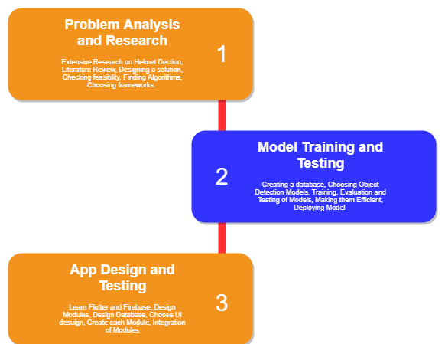
Proposed System - Workflow
Figure 1 : Proposed System – Workflow (1)

Slide 6
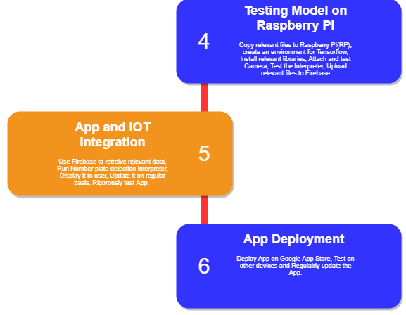
Proposed System - Workflow
Figure 2 : Proposed System – Workflow (2)

Slide 7
Problem Analysis and Research:
The most effective object detection models are Single Shot detectors.
The metric used to evaluate an Object detection Model is called Mean Average Precision.
Currently the best, most efficient Model for Object detection is called EfficientDet.
EfficientDet has a Lite version which can work with much less computing power while maintaining its mAP score.
The TensorFlow framework is the best choice because we can further optimize the Model using TFLite converter(TOCO).
The model can further be optimized using Quantization.
The model post conversion and quantization can be used for interpretation on the Raspberry PI.

Slide 8
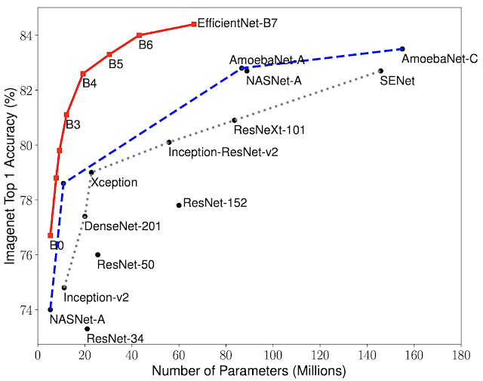
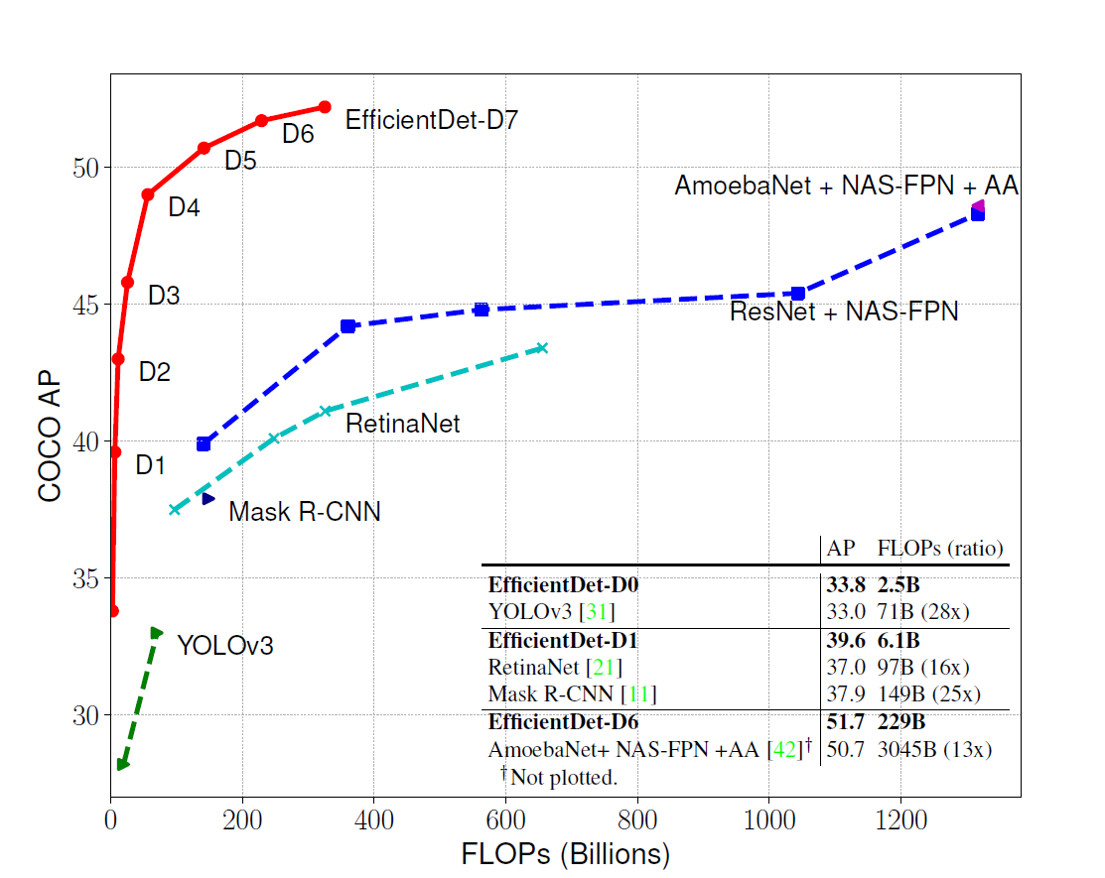
Problem Analysis and Research:
Figure 3 : Model Size vs. Accuracy Comparison. EfficientNet-B7 achieves new state-of-the-art 84.4% top-1 / 97.1% top-5 accuracy, while being 8.4x smaller than the best existing CNN.

Slide 9
Problem Analysis and Research:
Figure 4 : Model FLOPS vs COCO accuracy - EfficientDet-D7 achieves new state-of-the-art 51.0% COCO mAP with 4x fewer parameters and 9.3x fewer FLOPS

Slide 10
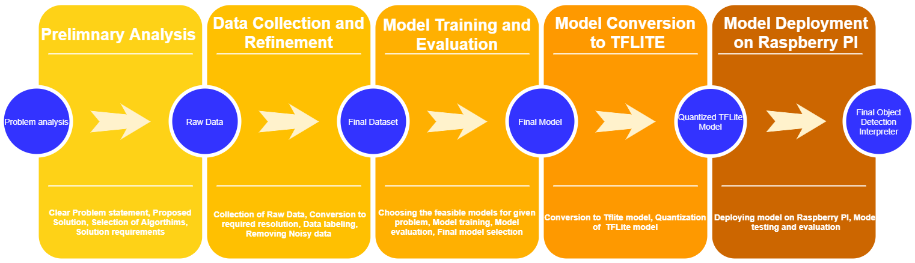
Model Testing and Training - Workflow
Figure 5 : Model Testing and Training - Workflow

Slide 11
Data Collection and Refinement
A) Data Collection
The search for a dataset for the problem i.e., Helmet Detection began online. Only one dataset was found which was relevant to the problem, which was from IIT Hyderabad. But it was not available for download to the general public.
So, a custom dataset had to be made. In total 3 datasets were prepared, out of which dataset 3 was used due to the Object detection model’s excellent performance after using it for training.
The first dataset was basically a set of 1080p videos at 30fps which were recorded on the Oppo Reno Smart Phone. The footage was recorded at a single location from 2 different angles. After recording the footage, screenshots were clicked which contained the required information as shown in Figure 6. This made up the first dataset.

Slide 12
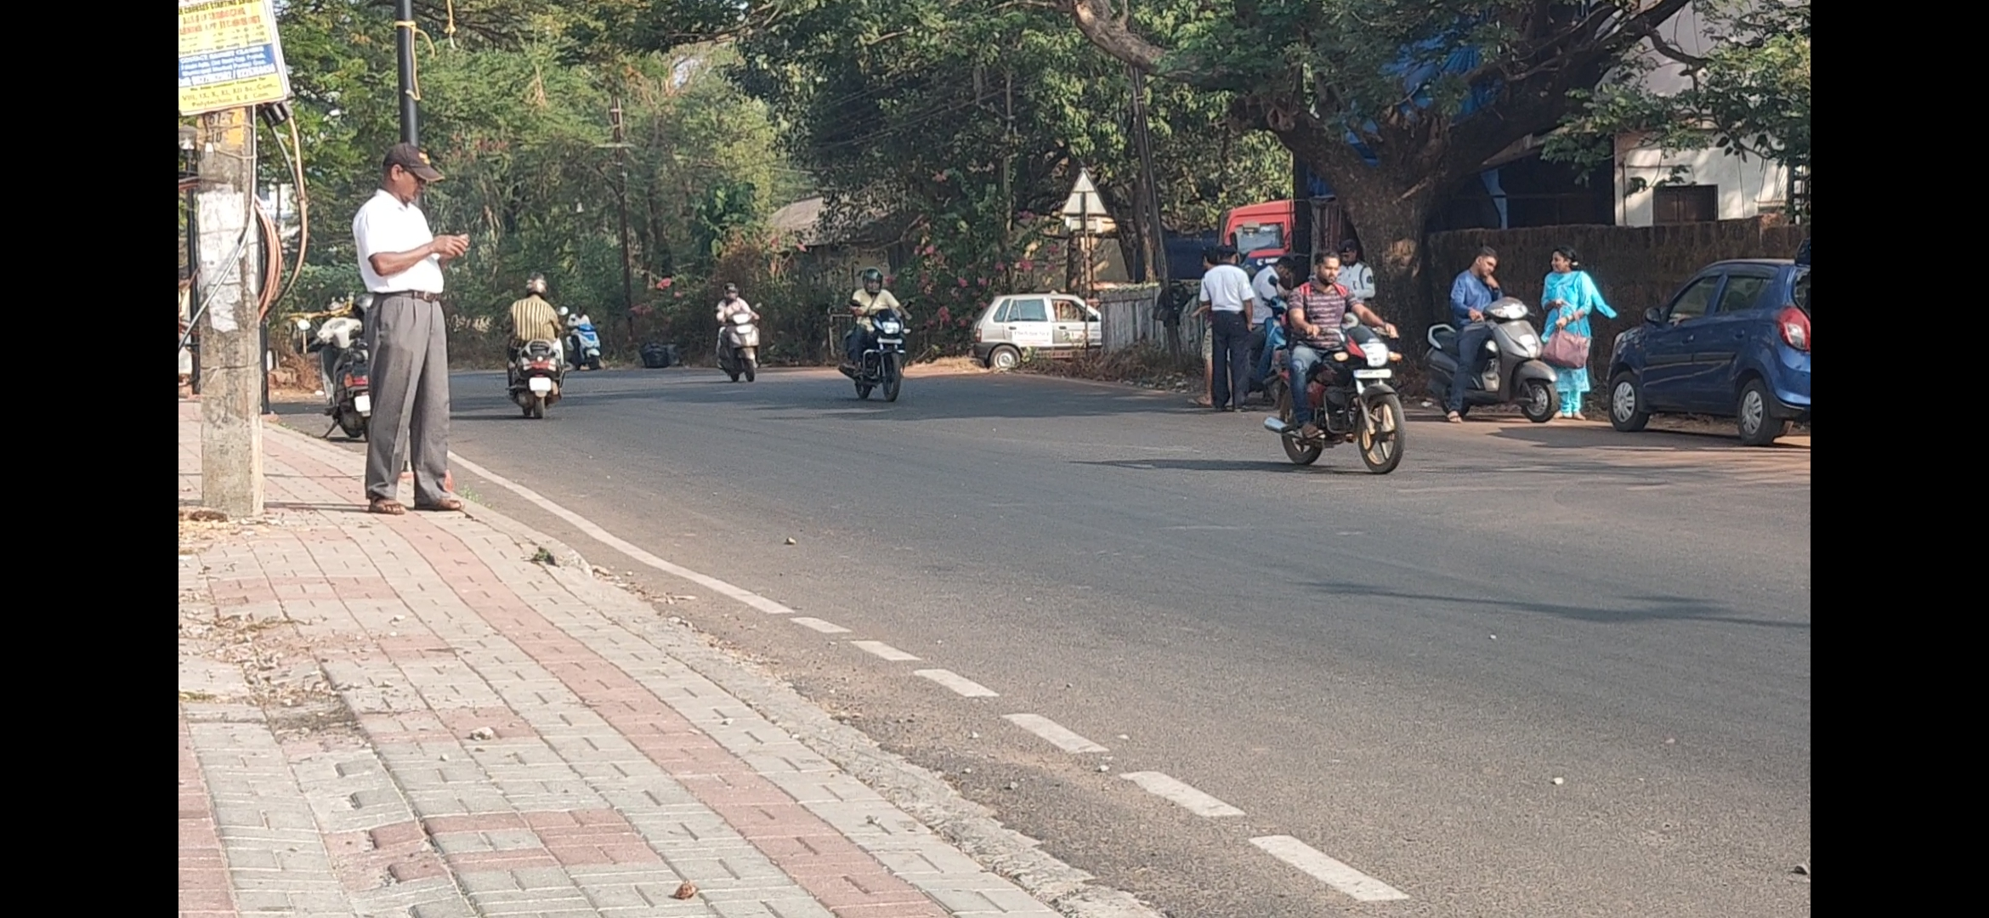
Data Collection and Refinement
Figure 6: Sample from Oppo Reno Video of Dataset 1

Slide 13
Data Collection and Refinement
The second dataset was made using the Nikon D5500 DSLR. Each photo has a resolution of 24.2 MP. Photos were clicked from 3 different locations. Only on the first location photos were clicked from 2 different angles. From the other 2 angles photos were clicked from one angle. A sample image is shown in Figure 7. For the third dataset, pictures were clicked from a single location and 2 different angles a sample of which is shown in Figure 8.
The final dataset contains 372 images in total.

Slide 14
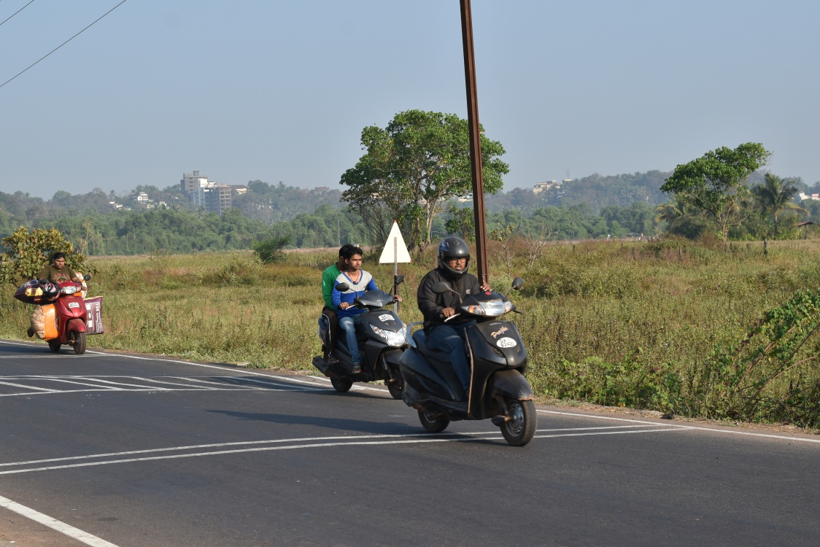
Data Collection and Refinement
Figure 7 : Sample from Dataset 2

Slide 15
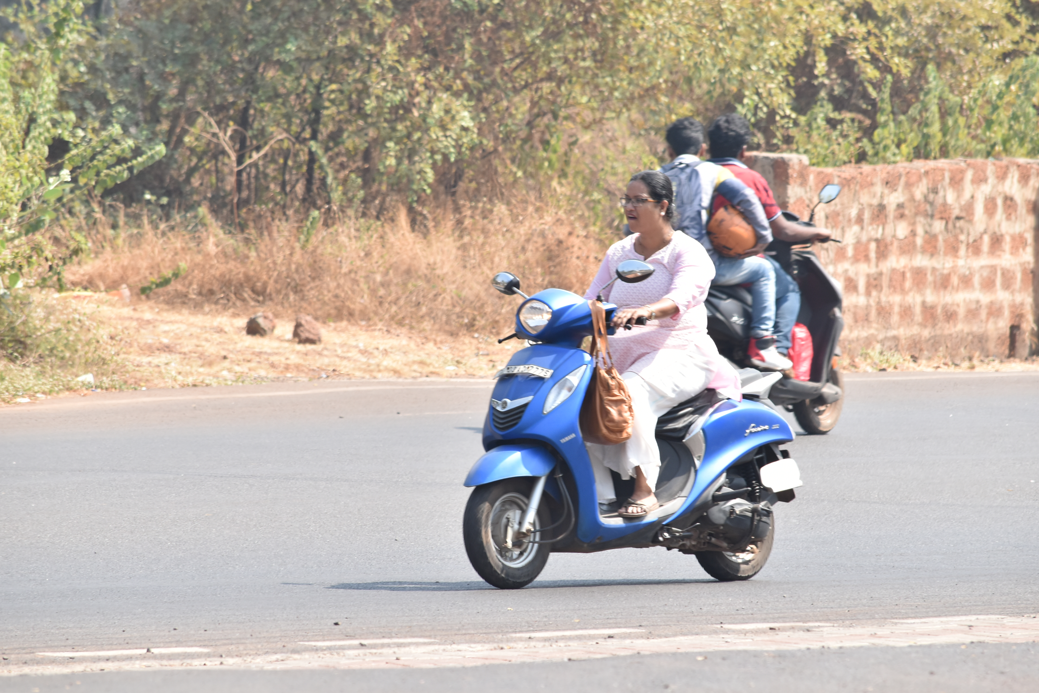
Data Collection and Refinement
Figure 8 : Sample from Dataset 3

Slide 16
Data Collection and Refinement
B) Dataset Labelling
For this step a python script developed by Darrenl tzutalin [1] was used. It’s free and open-sourced code designed to label Image data for Object Detection. It has a user-friendly UI with which we need to tag the objects in the image as shown in Figure 9. Using this software around 800 images were labelled. Each image having anywhere from 1 to 20 labels depending on the approach used. LabelImg saves a .xml file containing the label data for each image. These .xml files will be later used to generate TFRecords.

Slide 17
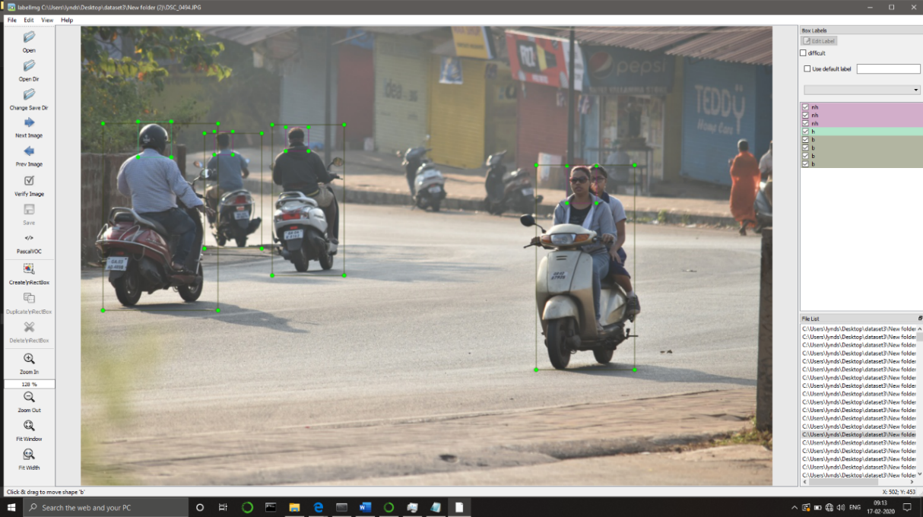
Data Collection and Refinement
Figure 9: Labelling a sample from Dataset 3

Slide 18
Data Collection and Refinement
C) Dataset Pre-processing
The Images were resized to 1/8th of their original resolution using OpenCV, so training becomes much easier and all the data is normalized. To generate the TFRecords that serve as input data to the TensorFlow training model, we use object_detector.DataLoader.from_pascal_voc. The method is similar to generate_tfrecord.py[2] which takes in csv files generated from the xml files and generates TFRecords. After running the method, we should have all the necessary TFRecords files for training the model.

Slide 19
Model Training and Testing
After the collection of data and the creation of a usable dataset, the dataset was split into train, test and validation datasets.
The concept of transfer learning was used to lower the training time and improve the overall model Map score.
8 Models were trained with the dataset with mAP scores ranging from 35 – 70% the upper limit of which is considered state of the art.
Since the situation calls for a good mix of less FLOPs and an above average mAP score the Efficient Det 0 model was chosen.
This model was then converted TFLite equivalent and Quantized for maximum efficiency.
The model was then Deployed to the Raspberry Pi and showed Excellent performance.
Metrics: 'AP': 0.62807864, 'AP50': 0.9162149, 'AP75': 0.7078281 for Model Efficientdet0

Slide 20
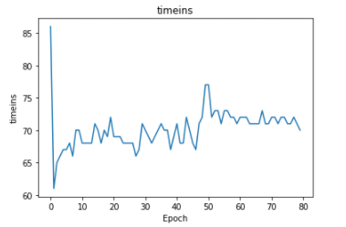
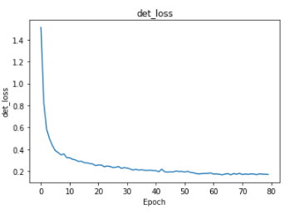
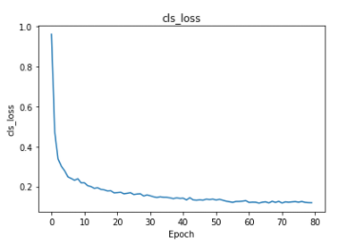
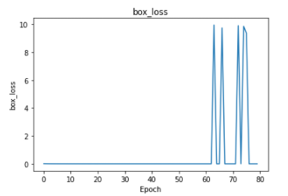
Model Training and Testing
Figure 10.1 : Example of detection using the model

Slide 21
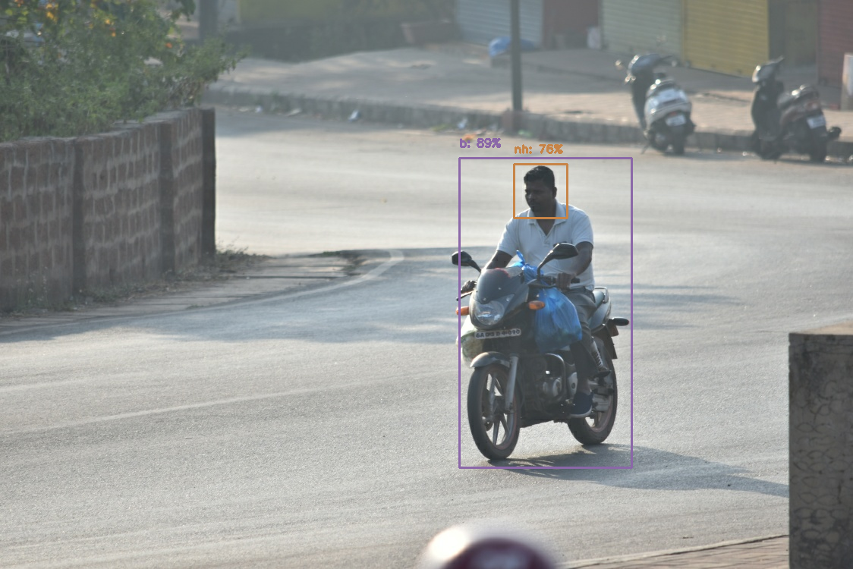
Model Training and Testing
Figure 10.2 : Example of detection using the model

Slide 22
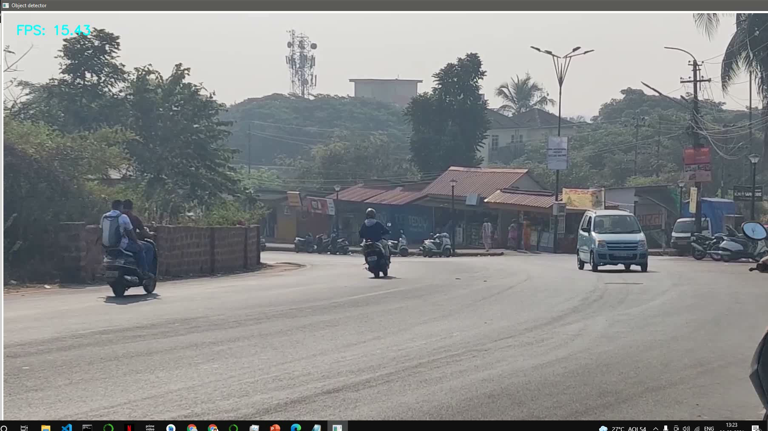
Model Training and Testing
Figure 10.3 : Example of detection using the model

Slide 23
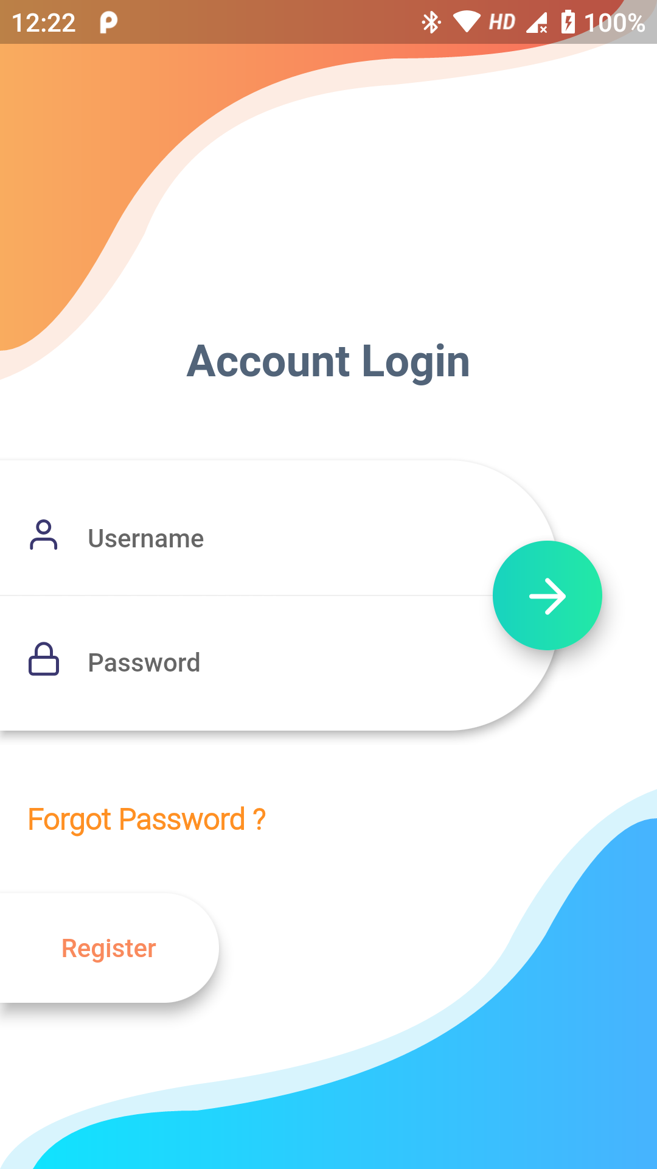

App Design and Testing
Figure 11 : Account Login UI
Figure 12 : Verify With Google UI

Slide 24

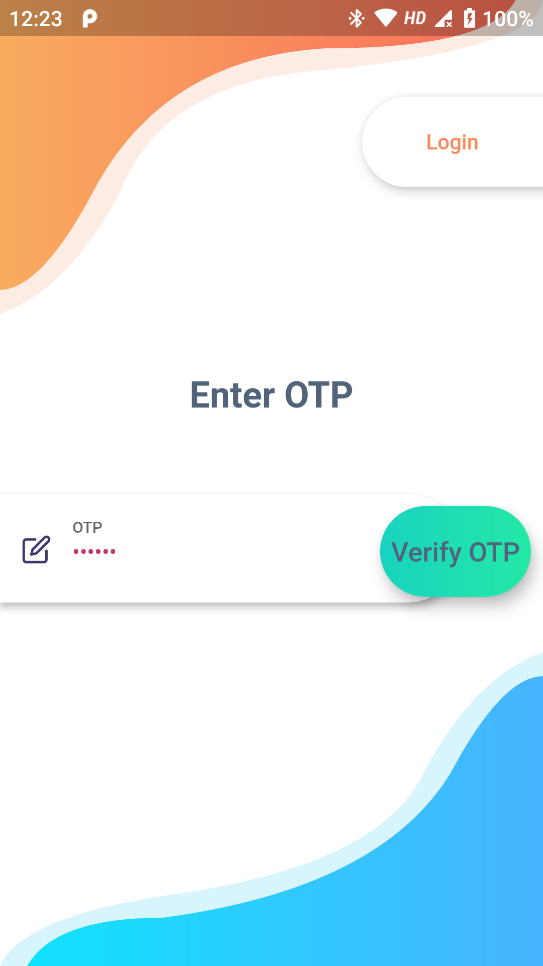
App Design and Testing
Figure 13 : Verify Mobile Number UI
Figure 14 : Enter OTP UI

Slide 25

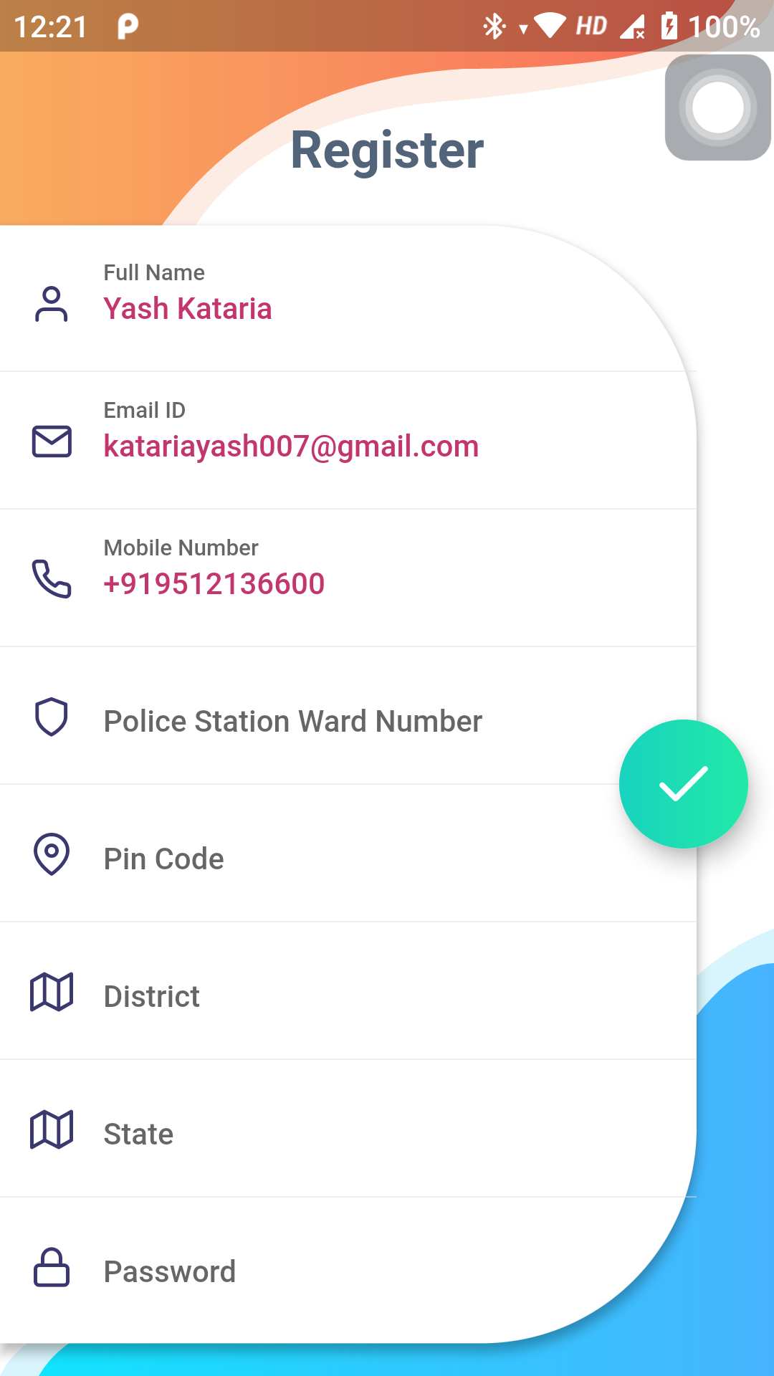
App Design and Testing
Figure 15 : Google Account Selection UI
Figure 16 : Basic Registration UI

Slide 26
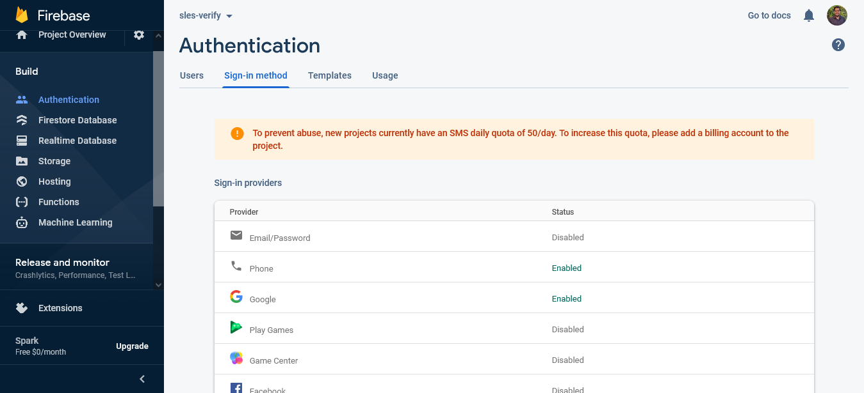
App Design and Testing
Figure 17 : Backend – Modes of Authentication

Slide 27
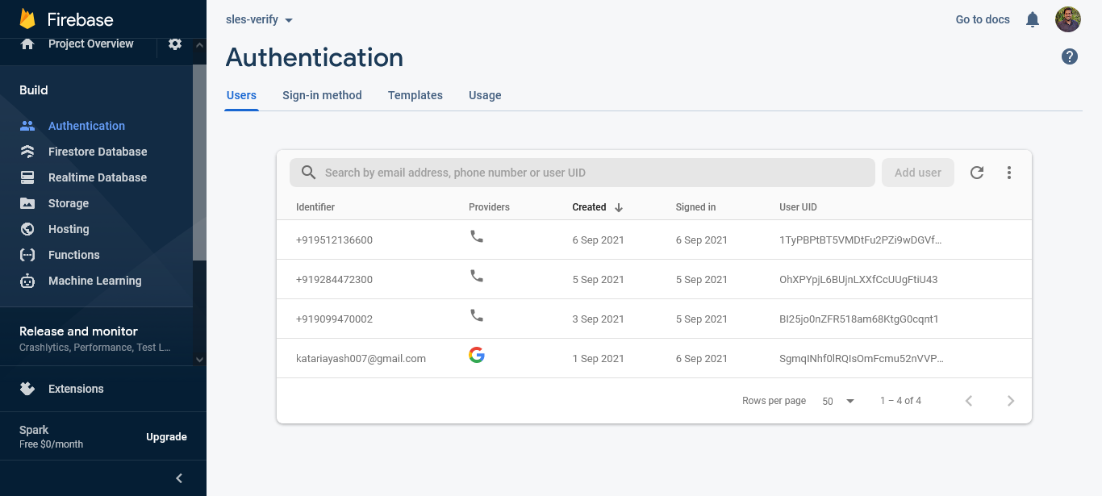
App Design and Testing
Figure 18 : Backend – Authenticated Users

Slide 28
Thank You!

Slide 29
References
[1]https://github.com/tzutalin/LabelImg
[2]https://github.com/datitran

